Slide 1
SCIENCE IN SPORT
COMMERCE · CRO AUDIT
HEATMAP & SCROLLMAP
INTELLIGENCE
The full Crazy Egg behavioural audit: 43 maps across 11 pages, desktop and mobile, read through the Brand Brain and hydration CRO logic.
FILE TYPE
OWNER
DATE
DOCX
M. Lucas & A. Hickling
21 Jul 2026

Slide 2
COMMERCE · PART A
READING TWO MAPS TOGETHER
▸ Click heatmap: warm = high click density. Look for the first strong cluster, clicks on non-clickable things, and whether proof elements get engaged.
▸ Scrollmap: warm = high % of visitors reached this depth. Blue zone = reached by a minority; green zone = seen by most.
▸ Green scroll + cold clicks: seen but ignored — a content/proof-integration problem. The most common pattern in the SiS set.
▸ Blue scroll + cold clicks: genuinely unseen — a placement and hook problem.
The correction this version makes: people DO scroll into the education. What they don't do is act on it. Attention continues where engagement dies.
SCIENCE IN SPORT · BRAND PORTAL
2

Slide 3
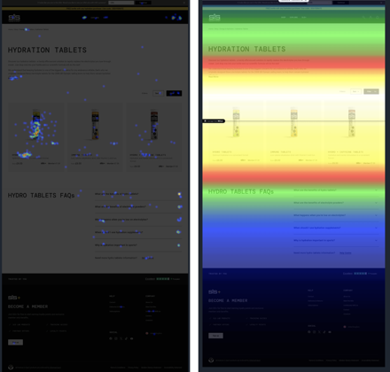
COMMERCE · PART B
1. HYDRATION TABLETS (PLP)
Reading: classic bottom-loaded proof — trust marks unseen and unclicked, FAQ clicks show people hunting for reassurance.
Fix: lift a trust strip to the top, add star ratings + use-case line to each product block.
Click heatmap (left) and scrollmap (right)
SCIENCE IN SPORT · BRAND PORTAL
3

Slide 4
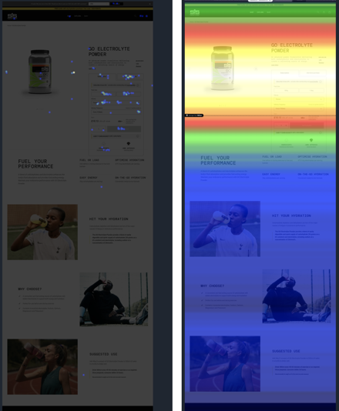
COMMERCE · PART B
2. GO ELECTROLYTE POWDER (PDP)
Reading: still not getting past the fold; information panels largely ignored.
Fix: tell the audience what they need sooner; speed up the configuration step.
Click heatmap (left) and scrollmap (right)
SCIENCE IN SPORT · BRAND PORTAL
4

Slide 5
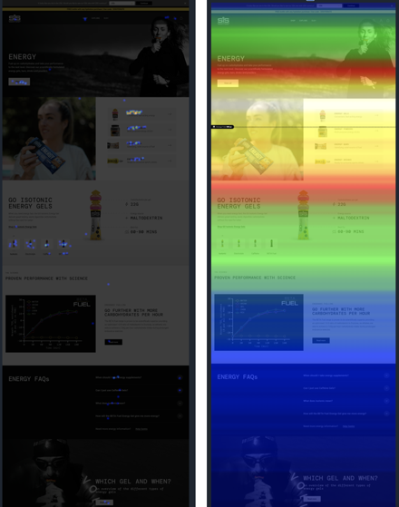
COMMERCE · PART B
3. ENERGY (CLP)
Reading: routing tiles do real work, but the science strip and proof lower down cool off.
Fix: keep the tiles, move a proof beat up beside them.
Click heatmap (left) and scrollmap (right)
SCIENCE IN SPORT · BRAND PORTAL
5

Slide 6
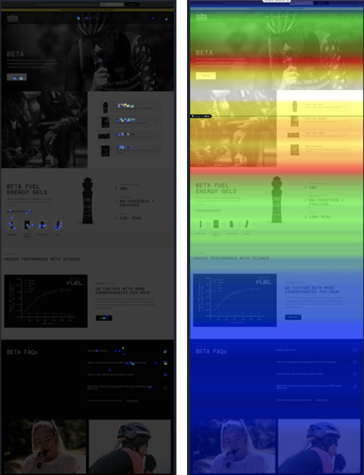
COMMERCE · PART B
4. BETA (CLP)
Reading: seen but ignored — dark mood hero gives few obvious things to click.
Fix: add a routing question high on the page; lead with the stake, not the mood.
Click heatmap (left) and scrollmap (right)
SCIENCE IN SPORT · BRAND PORTAL
6

Slide 7
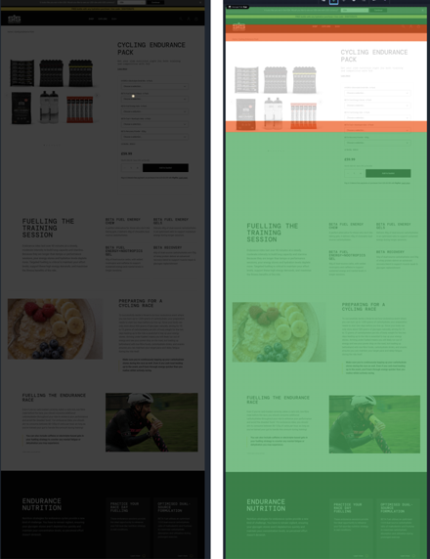
COMMERCE · PART B
5. CYCLING ENDURANCE PACK (BDP)
Reading: the sharpest example of the pattern — education is reached (green scroll) but generates almost no clicks.
Fix: activate the guide: proof + CTA inside it, not just relocate it.
Click heatmap (left) and scrollmap (right)
SCIENCE IN SPORT · BRAND PORTAL
7

Slide 8
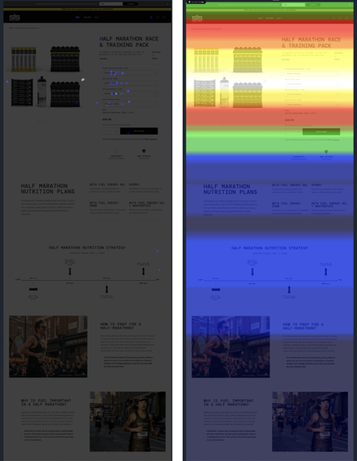
COMMERCE · PART B
6. HALF MARATHON PACK (BDP)
Reading: buy block weakly engaged; fuelling guide under-reached and under-clicked.
Fix: open with the stake, route selectors by goal, inject proof at the decision.
Click heatmap (left) and scrollmap (right)
SCIENCE IN SPORT · BRAND PORTAL
8

Slide 9
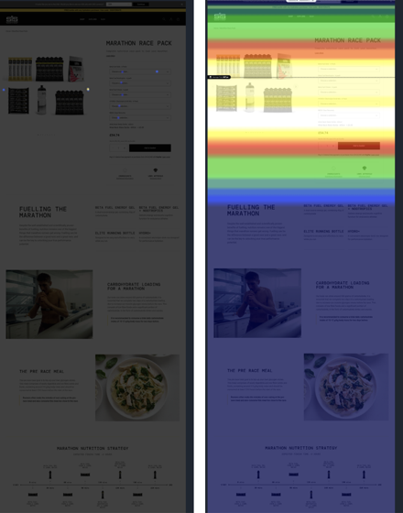
COMMERCE · PART B
7. MARATHON RACE PACK (BDP)
Reading: the fuelling guide is genuinely under-reached — a placement problem, not just content.
Fix: needs the hook highest of all — stakes + proof above the buy block.
Click heatmap (left) and scrollmap (right)
SCIENCE IN SPORT · BRAND PORTAL
9

Slide 10
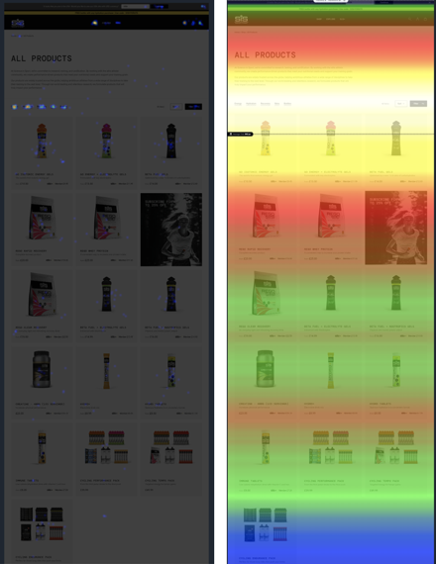
COMMERCE · PART B
8. ALL PRODUCTS (SHOP)
Reading: choice overload — clicks scatter and reach for filter pills.
Fix: lead with shop-by-need routing above the grid.
Click heatmap (left) and scrollmap (right)
SCIENCE IN SPORT · BRAND PORTAL
10

Slide 11
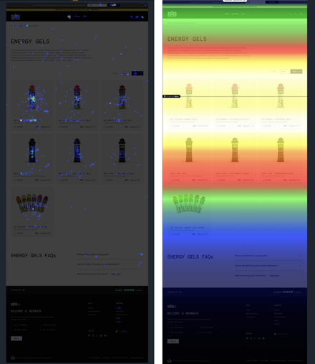
COMMERCE · PART B
9. ENERGY GELS (PLP)
Reading: healthier than shop-all — grid gets clicked, but no proof sits on the tiles.
Fix: add rating + review count and a best-for tag to each tile.
Click heatmap (left) and scrollmap (right)
SCIENCE IN SPORT · BRAND PORTAL
11

Slide 12


COMMERCE · PART B
10. MOBILE BEHAVIOUR
Reading: clicks concentrate tightly on buy controls; proof-seeking is even clearer on mobile.
Fix: give mobile its own running order — proof and routing in screen 1–2.
GO Electrolyte PDP (left) and Energy category (right) — mobile
SCIENCE IN SPORT · BRAND PORTAL
12

Slide 13
COMMERCE · PART B
THE DIAGNOSTIC TABLE — 9 PAGES
Page | Scroll (seen?) | Clicks (acted?) | Diagnosis
GO Electrolyte PDP | Deep | On buy | Template
Energy Gels | Good | Grid + filters | Add proof
Energy category | Good | Tiles only | Add proof
Hydration Tablets | Medium | 1 product + FAQs | Proof up
All Products | Medium | Scatter + filters | Route by need
Cycling Endur. Pack | Deep | Almost none | Activate guide
Half Marathon Pack | Medium | Selectors only | Hook + proof
Marathon Race Pack | Shallow | Almost none | Hook highest
Bike / BETA category | Deep | Sparse | Route + stake
The one place this breaks in SiS's favour: the PDP reviews, where proof is present at the decision and gets clicked.
SCIENCE IN SPORT · BRAND PORTAL
13

Slide 14
COMMERCE · PART C
THE FIVE FIXES, RANKED BY LEVERAGE
1 — PROOF
2 — ACTIVATE
3 — ROUTE
4 — STAKE
5 — MOBILE
★
▸
⌖
!
📱
ON EVERY PRODUCT
DON'T JUST RELOCATE
BY NEED, NOT SKU
NOT THE MOOD
ITS OWN ORDER
Where: Tiles, blocks, selectors
Problem: Green scroll, cold clicks
Evidence: Filter-pill demand
Losers: BETA, Marathon Pack heroes
Status: WiP with dev
Proof it works: PDP reviews
Fix: Proof beat + CTA inside guides
Scope: Quick win + rebrand-scope fix
Fix: Lead with the consequence
Need: Proof/routing in screen 1–2
Rating + review count + one snippet, everywhere.
Integrate proof and a CTA into the fuelling guides.
Shop-by-need routing above the product wall.
Open on the number/consequence that matters.
Dedicated mobile running order.
SCIENCE IN SPORT · BRAND PORTAL
14

Slide 15
COMMERCE · PART D
THE UNIVERSAL RUNNING ORDER
Step | Move | Why
1 | Open on the stake, not the mechanism | Value Pyramid Level 1–2 — identity & performance
2 | Route by need, immediately | 3D context nudge — clear filter-pill demand
3 | Put proof ON the product, at the point of choice | Highest-leverage change — PDP reviews prove it works
4 | Activate the education, don't just display it | Reached-but-dead guides need a proof beat + CTA
5 | Stack authority proof next, not at the foot | 4D identity then 2D authority, at the evaluation moment
6 | Carry a slim trust strip from the top | Trustpilot + Informed Sport, persistent near the hero
7 | Keep FAQs late as objection handling | Promote most-clicked answers higher up
SCIENCE IN SPORT · BRAND PORTAL
15

Slide 16
COMMERCE · PART D
TUNED BY SEGMENT
88.1%
Growth
Restart
1% / £563
DORMANT — PROOF + STAKES-FIRST
ACTIVE MID-TIER — RACE-DAY SNIPPETS
AT RISK — AUTHORITY CAPSTONE
CHAMPIONS — WIDEN THE BASKET
Do this first: add rating + review count + one CONFIRMED snippet to every product tile, block and selector, plus a slim trust strip near the top of every page.
SCIENCE IN SPORT · BRAND PORTAL
16

Slide 17
LEAD WITH THE STAKE. ROUTE BY NEED. PUT THE PROOF ON THE PRODUCT.
▸ SiS's pages are seen more than they are acted on — the fix is proof on the product and education that does a job.
▸ The PDP reviews already prove this pattern works. The plan is to do it everywhere, consistently.
▸ Measure by re-running Crazy Egg after the proof-on-product change and watching the scroll-to-click gap close.
Science in Sport · Commerce · Heatmap & Scrollmap Intelligence · 43 maps, 11 pages · 1 Jul 2026 capture

